Slide 1
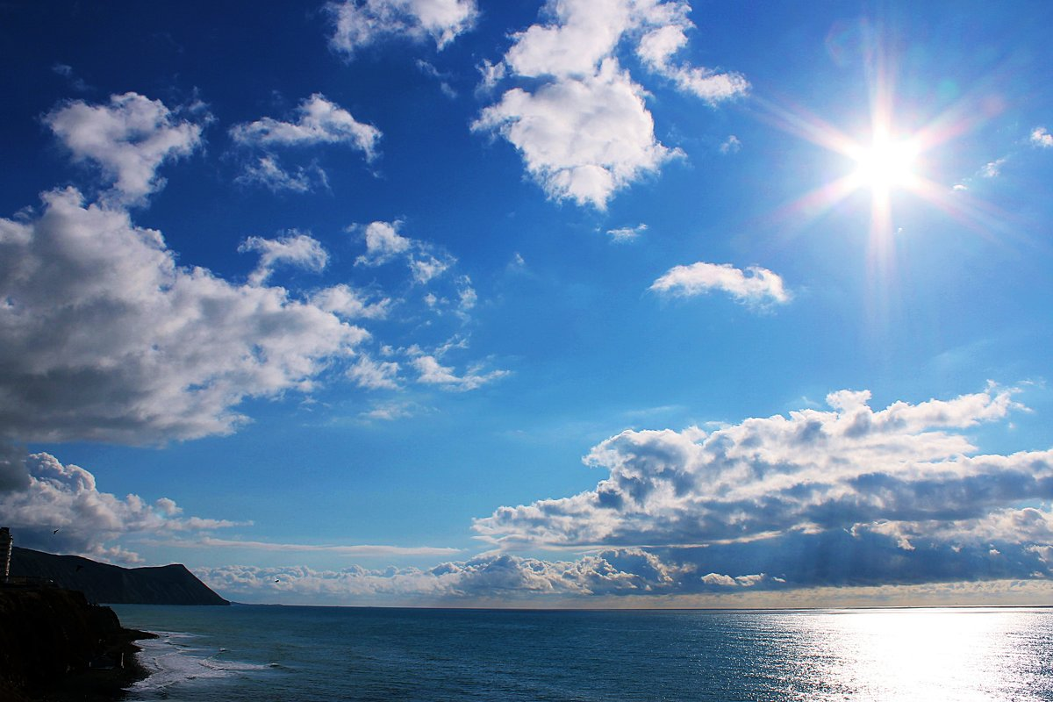
Basic Weather

Slide 2
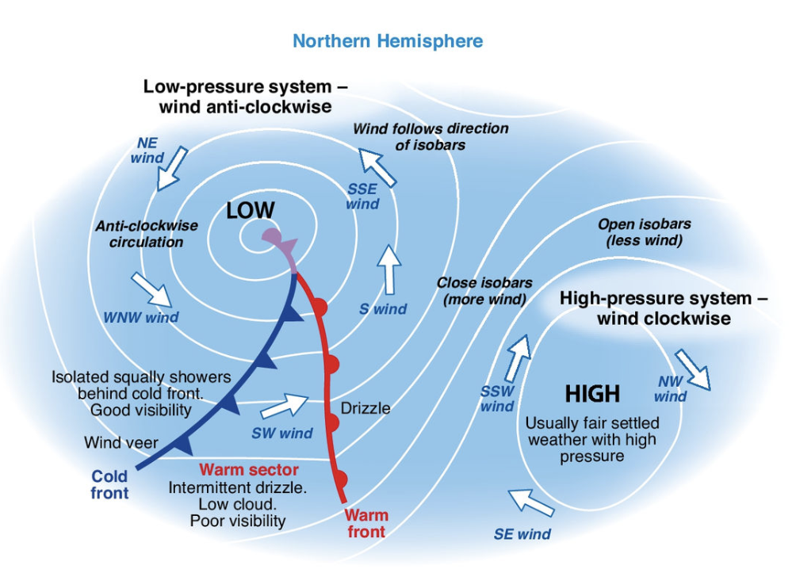
Basic Weather
The Causes of Weather
Weather is a key consideration when you go sailing.
Before you go afloat you should know the predicated wind strength and direction, and understand how any local effects may alter the forecast.
The weather we experience in the UK is Largely determined by Atlantic depressions and is caused by two types of weather systems:
Low-preasure systems (called depressions or lows)
High-pressure systems (highs or anticyclones)

Slide 3
Basic Weather
The Causes of Weather
Low-pressure systems travel across the Atlantic and are associated with:
strong winds
rain
shifting wind direction.
They also feature warm and cold fronts, the dividing lines between warm and cold air. Fronts are associated with changes in wind direction and often gusty conditions

Slide 4
Basic Weather
The Causes of Weather
High-pressure systems are born over land or sea and move more slowly, generally being associated with good weather and light winds

Slide 5
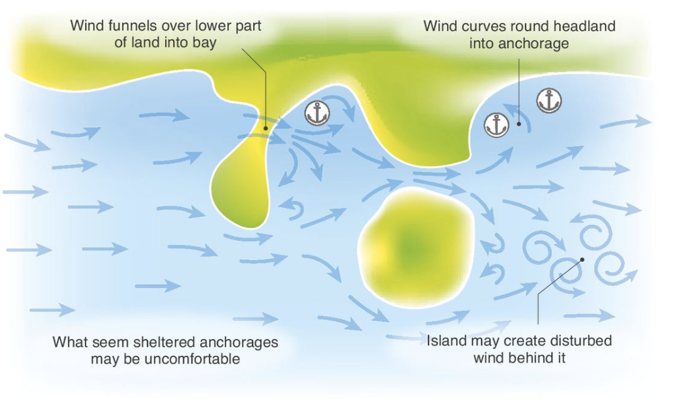
Basic Weather
Local Effects
Wind often differs from what has been forecast, which can be very frustrating. Two sailors discussing their day on the water may find that they have very different experiences even though they were sailing only a few miles away from each other.
Such differences can be due to the geography of the land, especially on large waters surrounded by hills producing their own localised climatic effects. In some wind directions this can produce a funnelling (venturi effects). For example, a prevailing Force 2 wind squeezed between two hills can exit the end of the valley at twice the strength.
This kind of knowledge can usually only be gained from local sailors. As you start to sail regularly at alternative location, in different condition, you will soon pick up on local knowledge and become better informed and competent sailors.

Slide 6
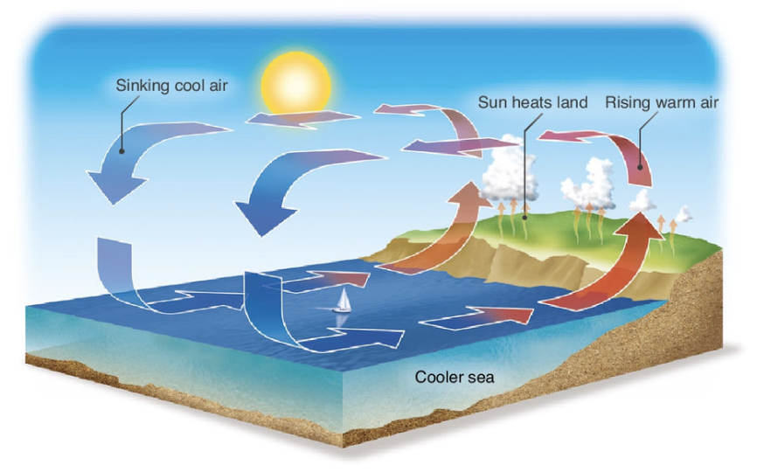
Basic Weather
Sea Breeze
There are other local effects that can cause the weather to vary from the forecast. For example, on bright summer days when the wind is light in the morning, there’s a good chance of a sea breeze later on in the day.
A sea breeze is a thermal wind generated by the temperature difference between the land and the sea. As the land warms up throughout the day warm air rises up from the land. This air is replaced by cooler air drawn off the sea which may generate a brisk onshore wind, either in the same or a different direction to that forecast. This effect tends to peak by mid-afternoon and can reach a good Force 4.

Slide 7
Basic Weather
Sea Breeze
The presence of strong sunshine is not a guarantee of a sea breeze, as even a light local wind can sometimes destroy this effect.
A tell-tale sign that a sea breeze is on its way is the formation of light, fluffy clouds over the coast. This means that hot air is rising and condensing.
For more in-depth knowledge on weather patterns, check out the RYA Weather Handbook.

Slide 8
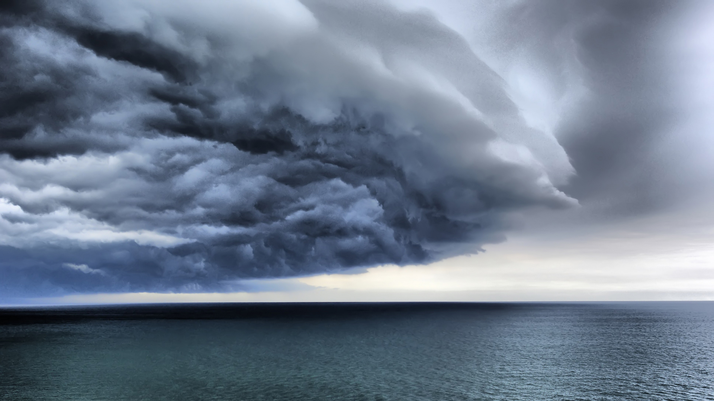
Basic Weather
Getting a Forecast
You do not need detailed knowledge of weather to go sailing but its is important to get a forecast.
Check the forecast for wind strength and direction as well as poor visibility or fog.
Good sources of weather information include:
Various websites
Mobile apps
Radio
Television
Phone
Harbour master office

Slide 9
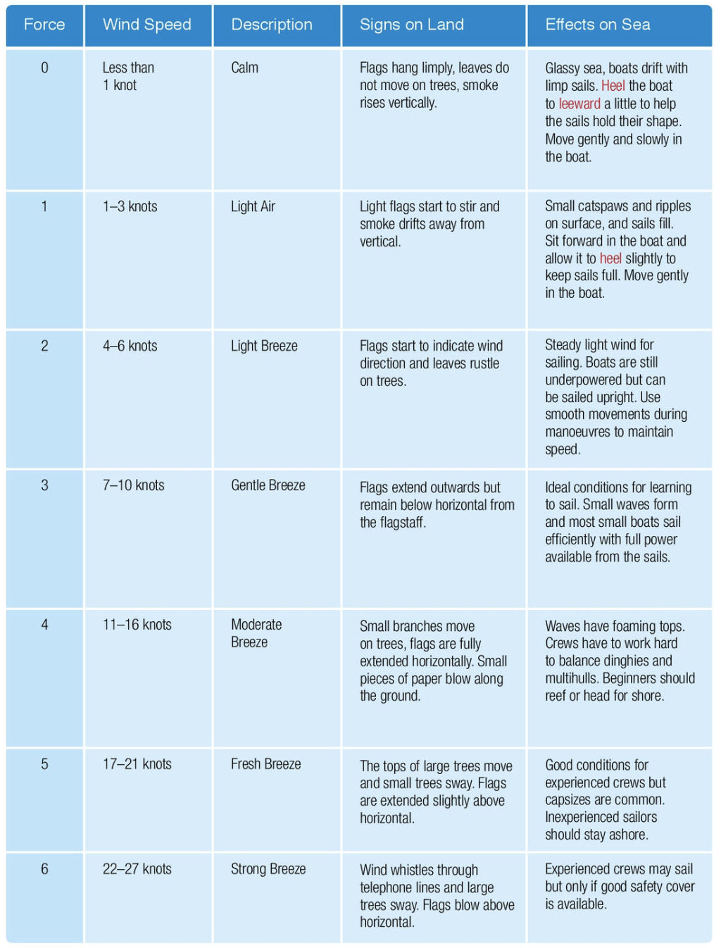
Basic Weather
Wind Strength and the Beaufort Scale
Wind strength is described in the Beaufort Scale.
Learn to recognise the strength of the wind by what you see ashore and afloat

